Slide 1
Flutter Mobile Application for
Car Parking
PRESENTED BY : ROBIN BIJU
ROLL NO : 37
S4 MCA
GUIDED BY : DEEPA THOMAS
ASSISTANT PROFESSOR
DEPT. OF CSE MCET

Slide 2
TABLE OF CONTENTS
Introduction
Abstract
Existing System
Proposed System
System Architecture
Flutter Architecture
App Layout
Conclusion
Reference

Slide 3
INTRODUCTION
In 2012 about 159 million new car registrations were announced, but in the 2002, there were at least 58 million new car registrations, predicting a 100% increase in 10 years.
Today transportation infrastructure and vehicle parking are considered insufficient to maintain the flow of vehicles on the road.
Off-road parking parks the car more systematically to get the most out of the parking slot, while on-road parking parks the car on the street in a disorganized way.
Nowadays parking problem is a major issue because of increasing in the no of vehicle's and it also results in congestion and traffic problems.
With the population over our country there increases the transportation in cities, the demand for parking spaces is additionally increased.
The Internet is widely used over the globe, by making use of the internet people can manage the parking system.

Slide 4
ABSTRACT
Car parking has become a serious issue in today's congested areas due to a lack of parking facilities.
In most metropolitan places, finding a parking spot is extremely tough and irritating, especially during rush hour.
In order to resolve these issues the proposed application makes it simple to reserve a parking space.
This programme allows users to view various parking spots as well as determine whether or not there is available space.
If the booking space is available, user can reserve it for a certain time frame.

Slide 5
EXISTING SYSTEM
Currently, there are fewer flutter applications that work with Android and IOS.
In the existing system one of the main issue faced by the user is the location problem for the parking and also it does not mention the parking places for the user.
Also, in the current system, it does not show the time limit for parking.

Slide 6
PROPOSED SYSTEM
The proposed application makes it simple to reserve a parking space.
This programme allows users to view various parking spots as well as determine whether or not there is available space.
If the booking space is available, user can reserve it for a certain time frame.
The effective management of available parking spaces is demonstrated, and the system might be expanded to conceal additional regions and venues.
Here we can access and book the parking slot where ever it is available in the mobile phone and it is user-friendly.
The overall system design consists of the following modules which provide a complete solution for the problems faced due to parking and searching for the availability faced by the users.

Slide 7
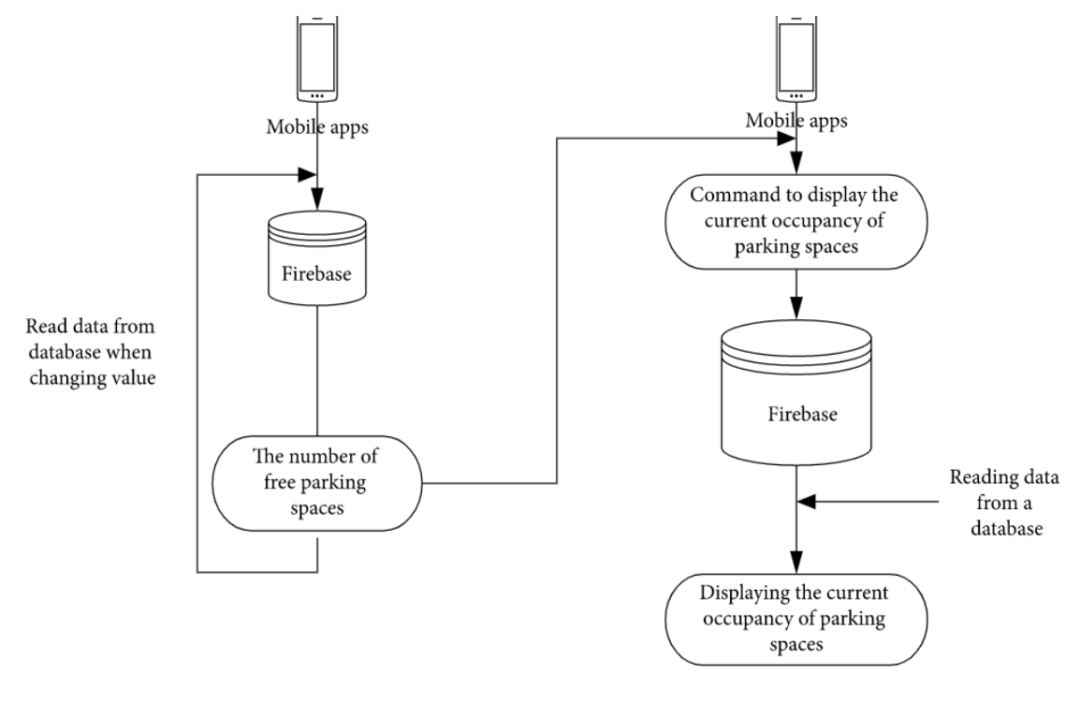
SYSTEM ARCHITECTURE

Slide 8
Unlike a traditional SQL database, which stores data in columns and rows in a table using SQL, each data that is stored in documents and collections format is stored in Cloud Fire store, which is NoSQL.
Cloud Fire store is designed to hold big groups of tiny documents, the data in the documents is comparable to JSON, however it is limited to 1MB in size.
Firstly using the application we need to find out a space for our parking, for that we check the firebase and find out the number of available free parking spaces.
Then read the data from the firebase and inform the user with the available free spaces for the parking.

Slide 9
After finding out the available free spaces next the user needs to search the current occupancy of the car parking from the firebase.
If there is an occupancy for parking, then sent the information from the firebase and display the current occupancy of the car parking to the user.
If there is no occupancy and free parking spaces then it automatically find out another suitable space for parking.

Slide 10
FLUTTER ARCHITECTURE
1. Flutter Engine:
It's a portable runtime for high-quality mobile applications.
It's built using the C++ programming language.
The flutter core libraries, which contain graphics and animation, network input output and file, plugin architecture, accessibility support, and a dart runtime, are used to create flutter applications.

Slide 11
2. Foundation Library:
Packages are the building blocks for developing a flutter application, and they are located in the foundation library.
Dart is the programming language that these libraries are written in.
Dart also comes with pre-installed libraries, the most popular of which are: Dart:core is used to provide core functionality and is included in all dart files.
For asynchronous programming, use dart:async, for mathematical functions and constants, use dart:math.

Slide 12
3. Widgets:
The widgets are the foundation of the Flutter framework.
Widgets are essentially user interface components that are utilized to form the application's user interface, in flutter the application is a widget.
The programme is the top-level widget, and its user interface is created by one or more children (widgets), which are then created by their offspring widgets.

Slide 13
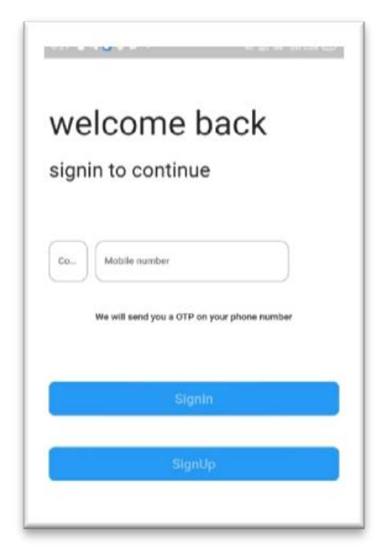
APP LAYOUT
Sign-in Page
This is the Sign-in page where we can login with Mobile Number and get OTP verification. Here admin and user Sign-in through same page.

Slide 14
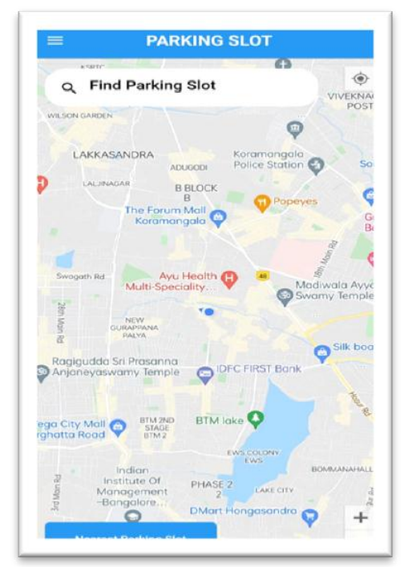
Finding Parking Slot
In this Find Parking Slot as the users can see their nearby parking slot and their location using Google API.

Slide 15
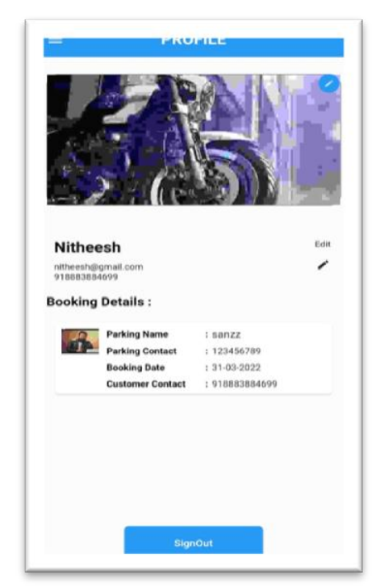
C. Profile Page
This is profile page where the details of the users and the booking details can be viewed and edited.

Slide 16
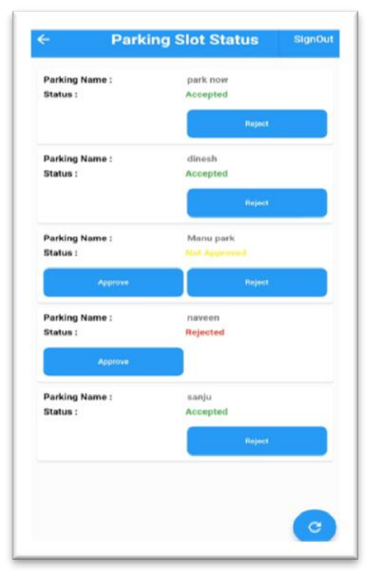
Admin-Verification Page
This page is used for Admin to check the parking slot status of the users so that admin can verify.

Slide 17
CONCLUSION
Flutter was used to develop this application because Flutter is currently one of the most exciting mobile technologies available.
Flutter is the greatest solution for businesses wishing to design apps for both iOS and Android.
It's the finest solution for creating apps with a great user interface and strong performance.
The proposed gadget lessens power frustration and site visitors via means of offering the nearest parking region and a to-be-had slot.
This utility may be person-pleasant for the customers so altogether it resolves issues like site visitors’ congestion, to seek out slots and to find a nearby parking spot.

Slide 18
REFERENCE
ShindeSmita N., ShindeKomal V., NagpureRashmila D. , Tupkar Avanti S., Prof.Ankoshe M. S.,” An Android Application for Parking Management and Dissemination System” ,IJARCET,Volume 4 Issue 3, March 2019.
HinaKousar, Kavitha Kumar, Shoney Sebastian,”Reservation Based Parking System with Dynamic Slot Allocation”,International Journal of Scientific and Research Publications, Volume 5, Issue 3, March 2019.
Bandi Sairam, Aditi Agrawal, Gopi Krishna, Dr. Satya Prakash Sahu, Automated Vehicle Parking Slot Detection System Using Deep Learning,ICCMC 2020.
Abrar Fahim, Mehedi Hasan b, Muhtasim Alam Chowdhury, Smart parking systems: comprehensive review based on various aspects, 2021.

